Slide 1
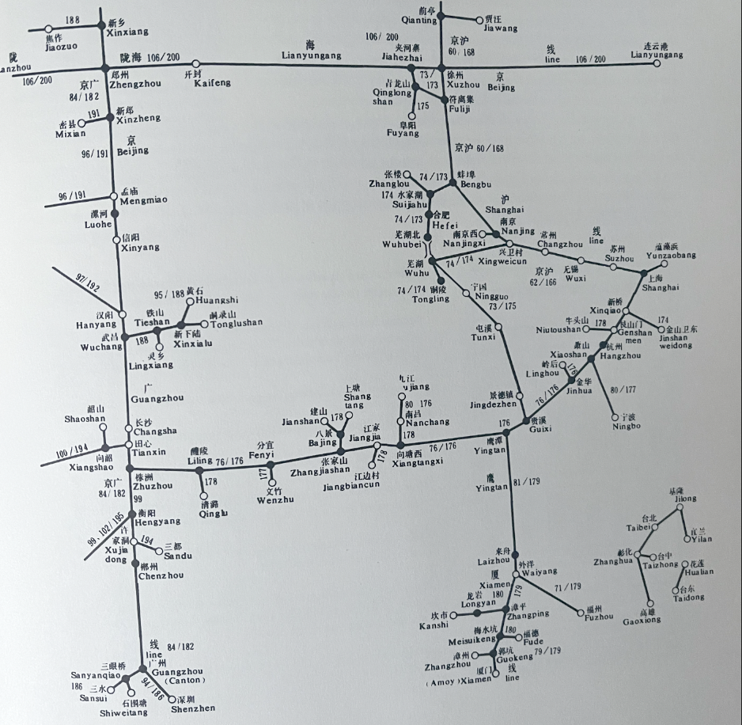
An Introduction to Graph Databases
Presented by: Grant Steinfeld
Last Updated March 2023 ( Deck Ver 3.0.0 )
Notes:
Tufte, Edwared, Envisioning information snippet of Japanese railway map?

Slide 2


Graph
Points
Edges
Notes:
Graph Theory Mathamtics
Grant
Steve
Grant - Steve
Edge pair a - b

Slide 3
Graph Datastructure
FOAF simple graph
GRANT
STEVE
REVATHI
Notes:
Math
Cyclic
Acyclic

Slide 4
Graph Theory
GRANT
STEVE
Verices
GRANT
STEVE
RREVATHI
Edge Pairs
G-S
S-R
R-S
REVATHI
Notes:
Math
Edges DIRECTED
Single or Multi-edge
Cyclic
Acyclic

Slide 5
Why store graph data in a graph store?
Isomorphic ( GraphQL )
Breaks the boundaries and limitations of RDBMS and NoSQL Document databases

Slide 6
2 flavors (generally ) – Graph vs Semantic
Graph e.g. Neo4j
Semantic e.g. AllegroGraph (?Neptune from AWS ? )
Proprietary
Open Source
Standard Query Languages

Slide 7
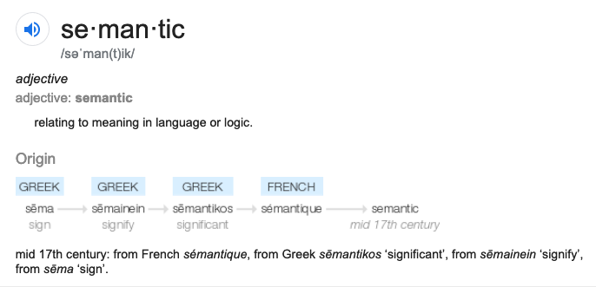
Semantic
MEANING | KNOWLEDGE
Notes:
Define

Slide 8

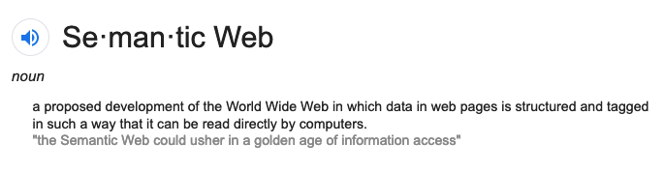
Golden age of Information Access

Slide 9
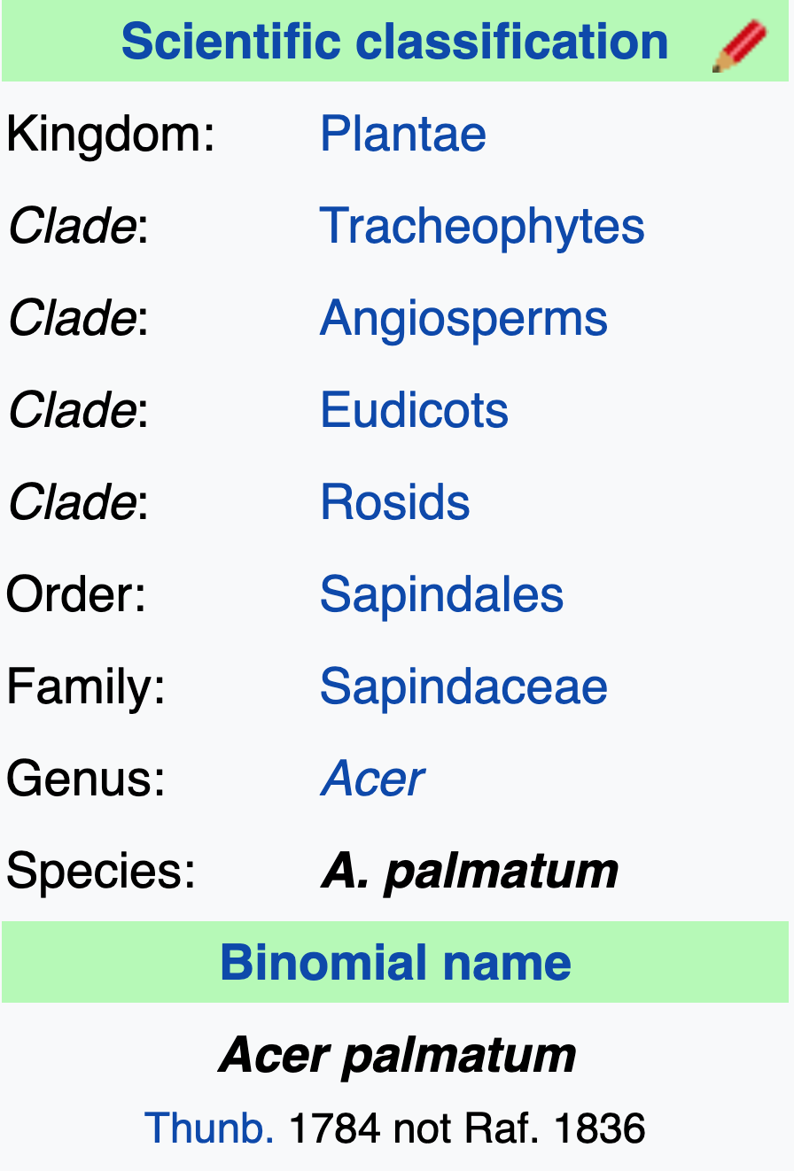

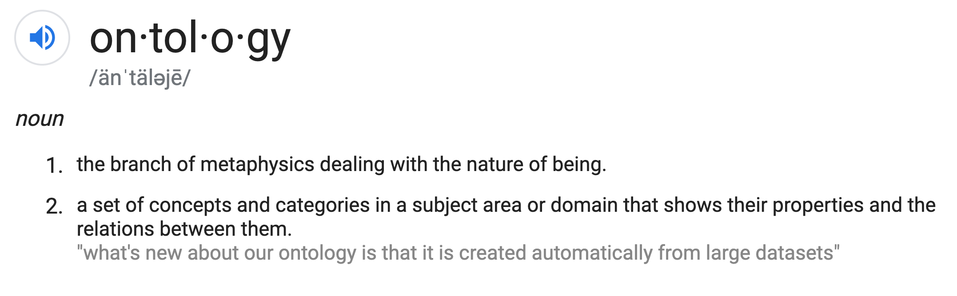
Ontology
Notes:
A set of concepts and categories in a subject area or domain that shows their properties and Relations between them

Slide 10
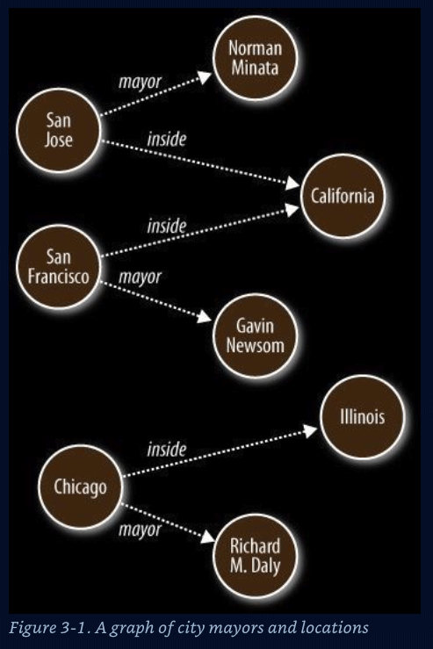
Vertices(data) and edges of a Semantic Graph
Nodes – Data Entities ( nouns )
S O
Edges – Relationships ( verbs )
P
Graph algorithms
Reasoning ( Decisions )
Inferences
Shortest path
Cliques / Neighborliness
Interconnected ness
Patterns
Notes:
Represent data that is hard to store in columnar and row format

Slide 11
The Triple Data Structure
Subject (S)
Predicate (P)
Ojbect (0)
Notes:
Fundamental datastruture
Directed relatikonship (P) 0r named edge between nodes (S or O)

Slide 12
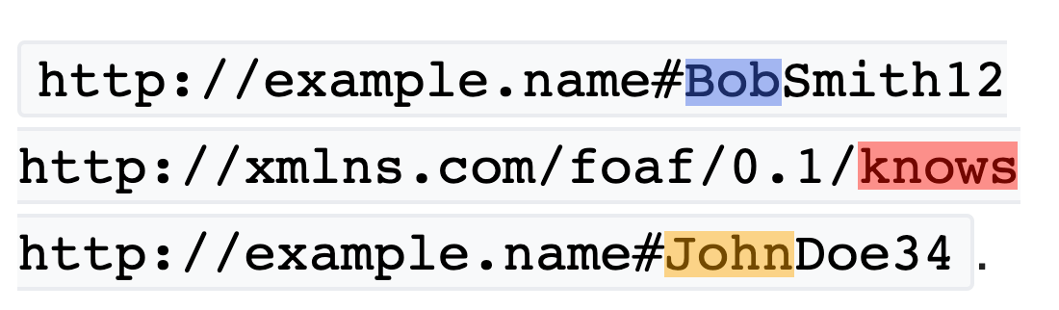
RDF Triples
SUBJECT
PREDICATE
OBJECT
Notes:
RDF extends the linking structure of the Web to use URIs to name the relationship between things as well as the two ends of the link

Slide 13
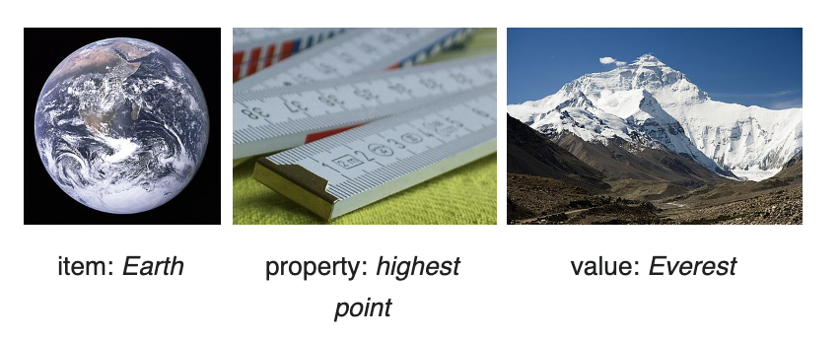
Modeling Data
https://www.wikidata.org/wiki/Help:About_data
Notes:
Subject --- Item === EARTH
Property --- highest point
Object --- Value === Mount Everest
…

Slide 14
Resource Description Framework (RDF)
Web model/standard for data interchange on the WWW
RDF has features that facilitate data merging even if the underlying schemas differ.
Supports `schema` evolution over time without requiring all the data consumers to be changed
Notes:
RDF – sums it up
RDF Schema is a set of classes with certain properties using the RDF extensible knowledge representation data model, providing basic elements for the description of ontologies. It uses various forms of RDF vocabularies, intended to structure RDF resources
Underpinnings of the www
The Resource Description Framework (RDF) language is used to express data about resources, where “resources” can be interpreted to be anything (a web page, a person, an idea, etc.). The basic building block is the triple, consisting of subject, predicate, object.
A first public draft of RDF appeared in October 1997, issued by a W3C working group that included representatives from IBM, Microsoft, Netscape, Nokia, Reuters, SoftQuad, and the University of Michigan. In 1999, the W3C published the first recommended RDF specification, the Model and Syntax Specification ("RDF M&S"). The RDF Schema class and property system is similar to the type systems of object-oriented programming languages such as Java.

Slide 15
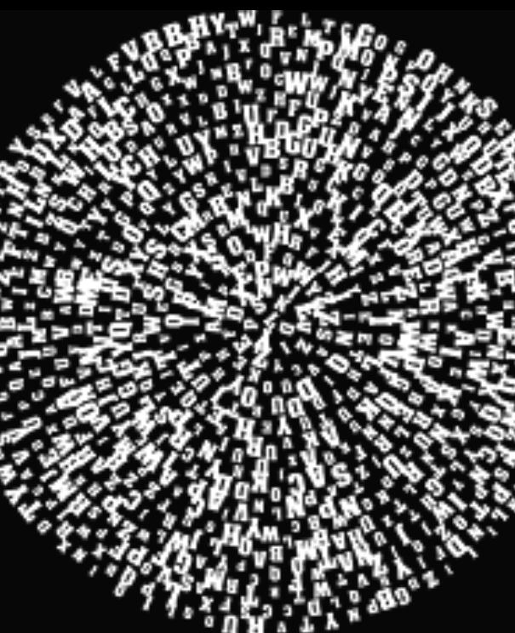
Triple `Soups`
Bowl -> Triple Store – Semantic Graph DB
`Alphabet soup` -> SPO OPS POS SOP POS
Merge ?
Notes:
Merge Using this simple model, it allows structured and semi-structured data to be mixed, exposed, and shared across different applications.

Slide 16
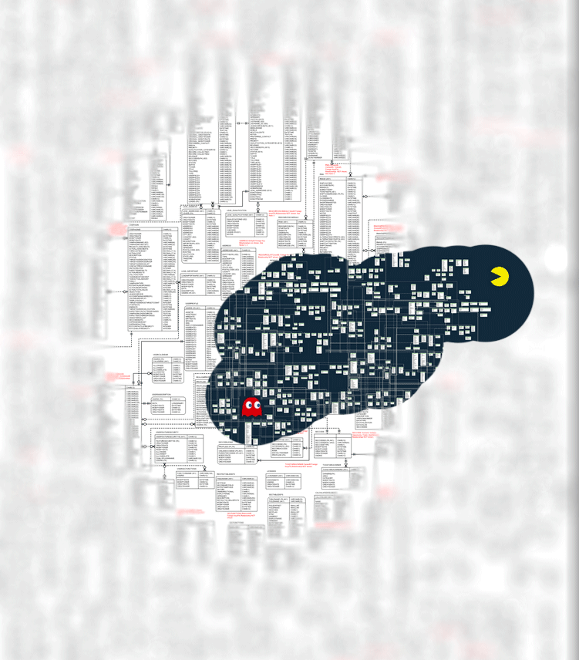
Inference New Ideas + Hypotheses Patterns
Notes:
LOOKING FOR
FINDING PATTERNS
Graph Theory
Cliques
Trav salemans
Shorest path
Knowledge graphs

Slide 17
Why is Graph useful
Network of nodes | Veritices joined by edges | 3 types of edges Uni-directinal Bi-directional No-direction I Line | Describes Pathways, trees and DAG’s ( Directed Acyclic Graphs ) | Semantic native datatype is the Triple
Points of data | Related by edges |  |  | 3 parts
 |  |  |  | Subject
 |  |  |  | Predicate
 |  |  |  | Object
 |  |  |  | SPO
 |  |  |  | Example
 | Subject | Predicate | Object/Subject | Predicate
 | Kevin Bacon | Co-acted-with | Rugter Hauer | Professional_title
 |  |  | dated | Object
 |  |  | Rachel Welch | Actor

Slide 18
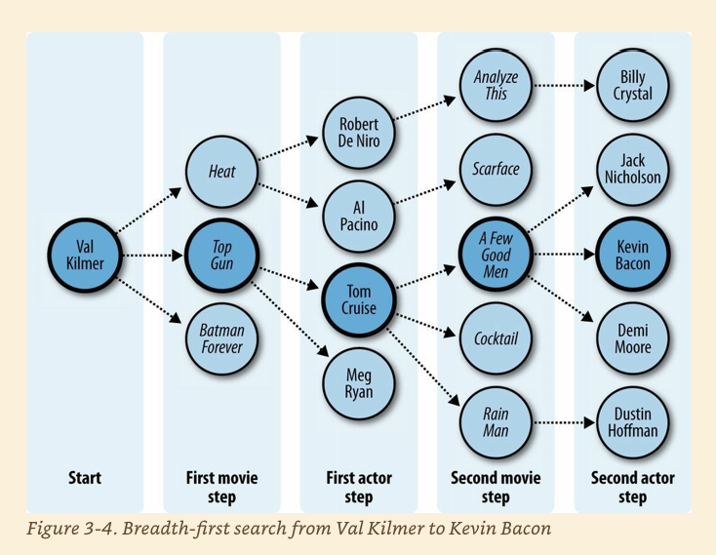
FOAF Six degrees of seperation
Notes:
﻿Six Degrees of Kevin Bacon A good example of the breadth-first search algorithm is the trivia game “Six Degrees of Kevin Bacon,” where one player names a film actor, and the other player tries to connect that actor to the actor Kevin Bacon through the shortest path of movies and co-stars. For instance, one answer for the actor Val Kilmer would be that Val Kilmer starred in Top Gun with Tom Cruise, and Tom Cruise starred in A Few Good Men with Kevin Bacon, giving a path of length 2 because two movies had to be traversed.
Evans, Colin. Programming the Semantic Web: Build Flexible Applications with Graph Data (p. 51). O'Reilly Media. Kindle Edition.

Slide 19
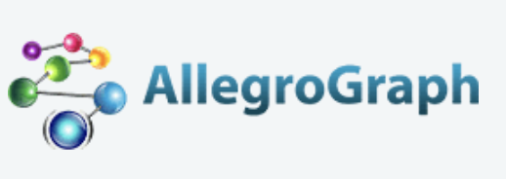
AllegroGraph - Overview
AllegroGraph Database is unlike traditional relational databases or more recently developed NoSQL databases or simple property graphs, it employs a combination of semantic graph (RDF, OWL, SPARQL) and document (JSON, JSON-LD) technologies that process data with contextual and conceptual intelligence.
AllegroGraph with FedShard™ is able to run queries of unprecedented complexity to support predictive analytics that help companies make better, real-time decisions.
AllegroGraph is designed to integrate with large corporate databases to build Knowledge Graphs for better business insights.

Slide 20
AllegroGraph – Some Use Cases
Medical Research
Bio-Informatics
SecDevOps
Portfolio Analysis
Fraud detection – AML
ML/Data mining
Social Networks - FOAF
See more: Financial and Banking industry use cases
Notes:
POPULARE
Basal III international regulations
Foreign corrupt Practices Act
UK Bribery Act
Fraud Detection
Personal Information security
New regulations on transfer pricing
To do add link to usecases off w3c?

Slide 21
Demo Time

Slide 22
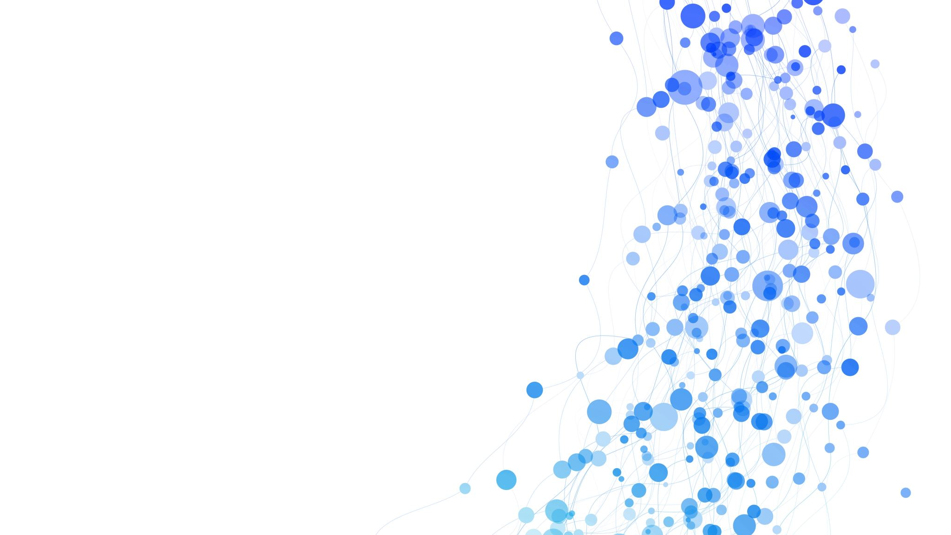
Online Demo - Common Eye Colors
Try out SPARQL - WikiData
Notes:
Try out SPARQL today – WikiData – part of Wikipedia

Slide 23
Modeling Data
https://www.wikidata.org/wiki/Help:About_data
Notes:
Subject --- Item === EARTH
Property --- highest point
Object --- Value === Mount Everest
…

Slide 24
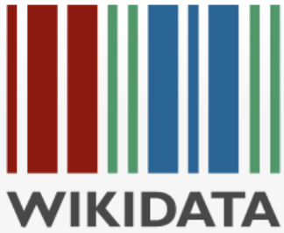
Understanding [Wiki] Data in the real-world
Structured data refers to data that has been organized and is stored in a defined way, often with the intention to encode meaning and preserve the relationships between different data points within a dataset … read more about WikiData …
Notes:
Understanding Wikidata

Slide 25
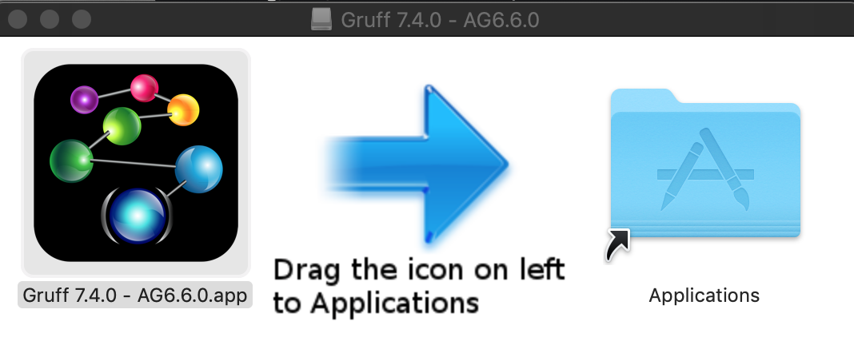
Demo
AllegroGraph – web view
Gruff web view
Notes:
Actor example
Wish: 6 degrees of separation query?
Show pizza in Web View - Add Triples … then display sample nodes

Slide 26
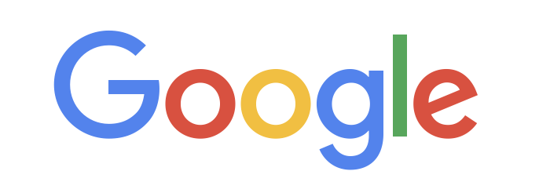
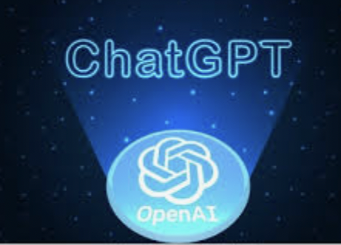
Semantic/Graph database top ranked
Neo4j
AmazonNeptune
AllegroGraph
Cosmos DB
"top 6 graph databases"
1. Neo4j
2. Amazon Neptune
3. OrientDB
4. ArangoDB
5. FlockDB
6. AllegroGraph
Notes:
Neo4j ( AWS Marketplace, SAAS Azure )
Amazon Neptune on AWS
Serverless graph database designed for superior scalability and availability
AllegroGraph – Docker standalone or VM image on all major Cloud offerings
Azure Cosmos DB for Apache Gremlin on Azure

Slide 27
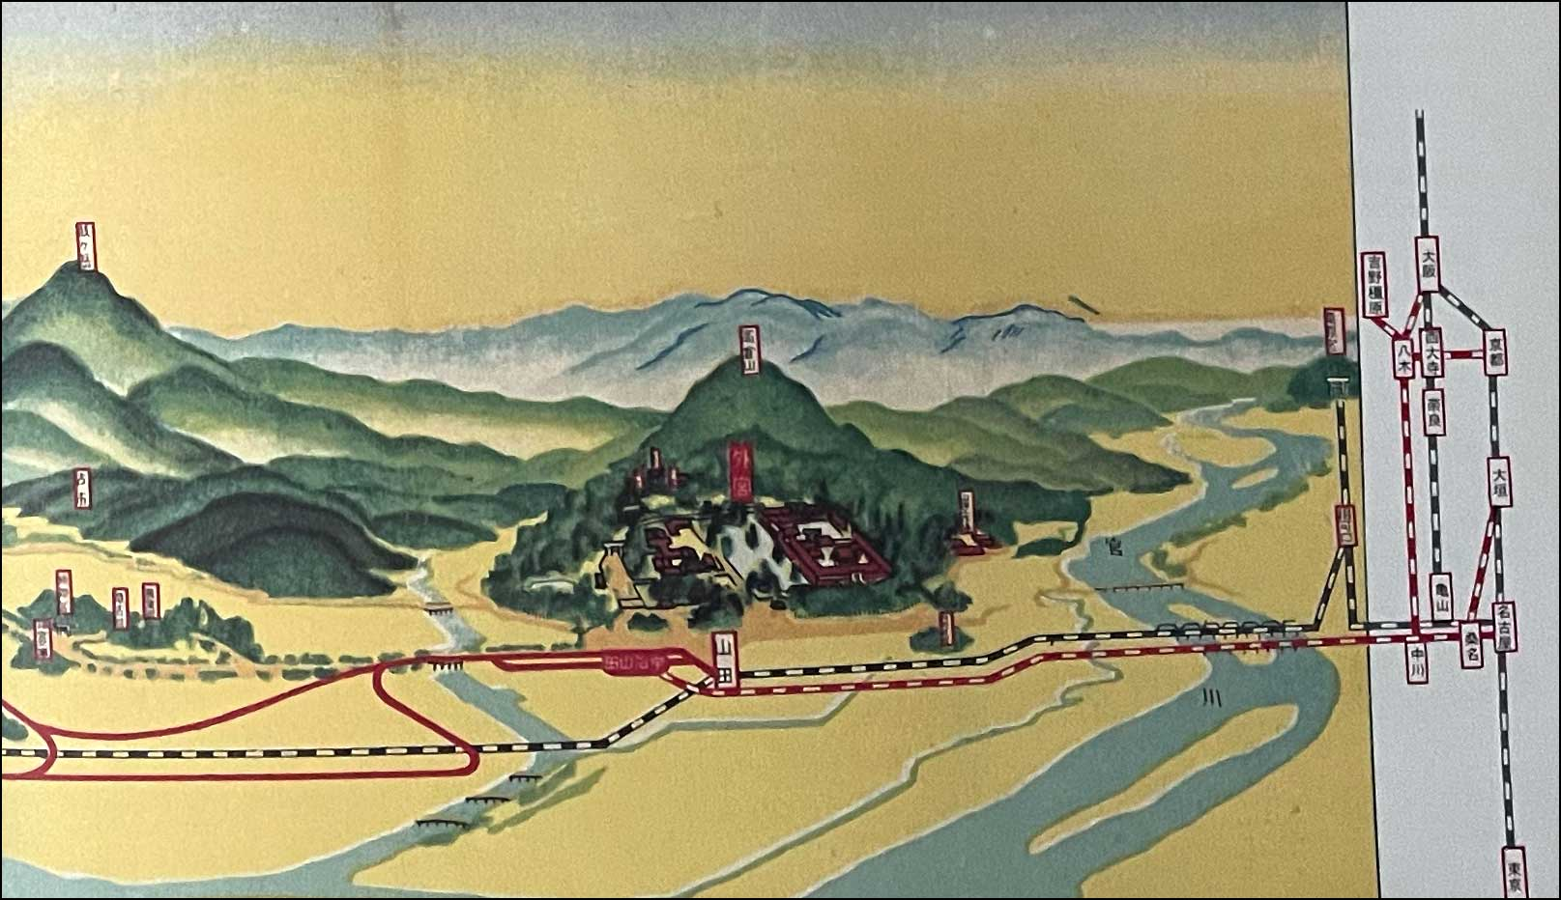
Escaping Flatland – recording life around us in a Multivariate way!
Real life events, imagination, biological , human, physical, observations, concepts, mappings etc
Are easy to describe in a picture, or in word, BUT how to represent these in a data (base)

Slide 28

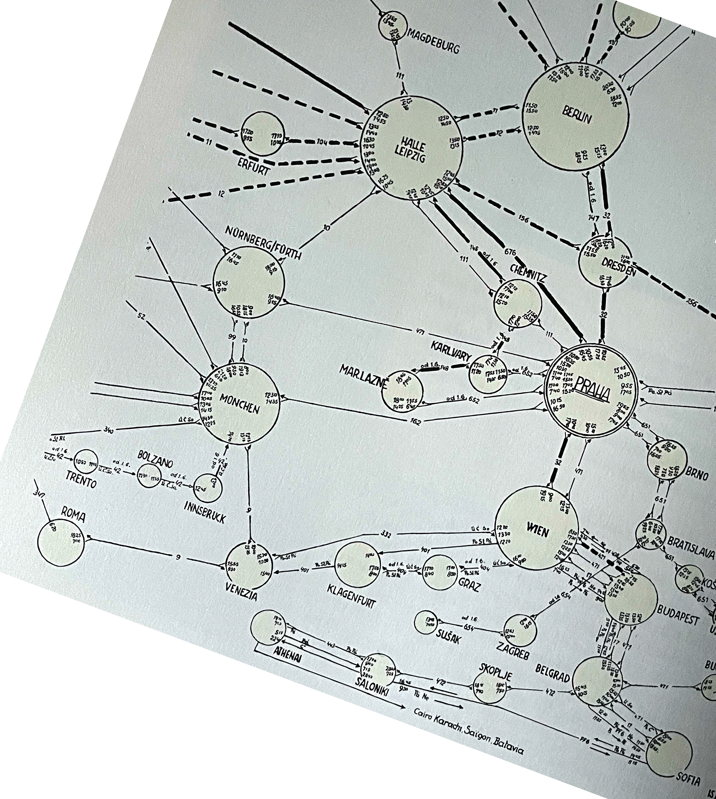
Representing maps and routes
Notes:
” A comprehensive narrative description of a transport system requires a record of both time and spatial experiences. Here a complex network of routes is brought together with flight times and identification numbers in an brilliant map/schedule for the
Czechoslovakia Air Transport Company in 1933.
A playful and Polished cover makes the brochure an exceptional union of graphic and information design”
Edward Tufte – Hardcover – 200? Envisioning Information pp102-103

Slide 29
3rd Party Integration
Python Anaconda
Ontop – SPARQL query RDBMS – Postgres …
NoSQL Ecosystem
MongoDB integration
Solr Text indexing
Notes:
Dodd-Frank Wall Street Reform
Mortgage and Loan rules and auditability of transactions
Credit Default Swaps ownership reporting
Know Your Customer requirements
Sarbanes-Oxley
Business and Legal Entity tracking requirements
Computation of derivatives risk
Basal III international regulations
Foreign corrupt Practices Act
UK Bribery Act
Fraud Detection
Personal Information security
New regulations on transfer pricing

Slide 30
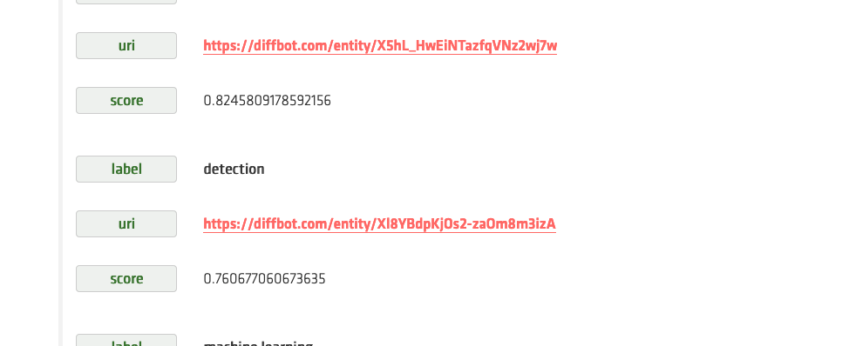
NLP: Entity, Keyword and Sentiment Extraction &( Example Triple Store Enrichment ➔ possible feed into a Graph Database/Lake

Slide 31
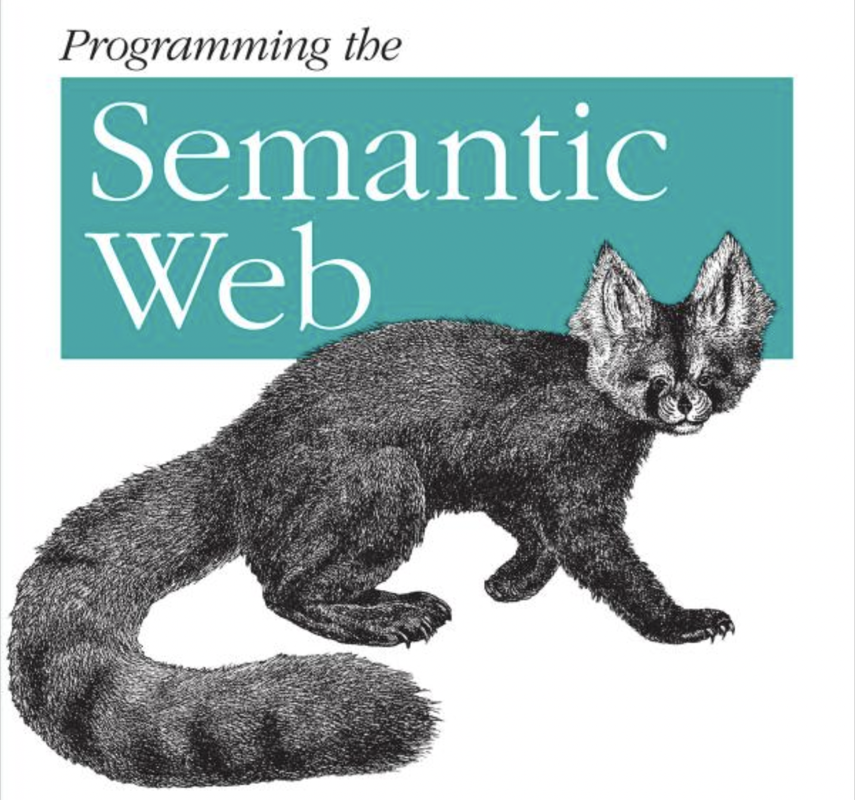
Seminal Text on the Semantic Web
Programming the Semantic Web: Build Flexible Applications with Graph Data 1st Edition ( Published, nearly 35 years ago, 2009)
Authors
Toby Segaran
Colin Evans
Jamie Taylor
Build
flexible
Applications with
Semantic data,
Expressed as a Graph Data
Notes:
Semantic data can be used to Express Graph DataStructures in a Graph Database ( Semantic Datastore/Database )
August 21st 2009
2023 currently Wed Feb 22nd
2009 Pulished
------------------------------------------
0034 years ago

Slide 32


Q&A
Grant.Steinfeld.Tech@gmail.com
https://github.com/Grant-Steinfeld

Slide 33

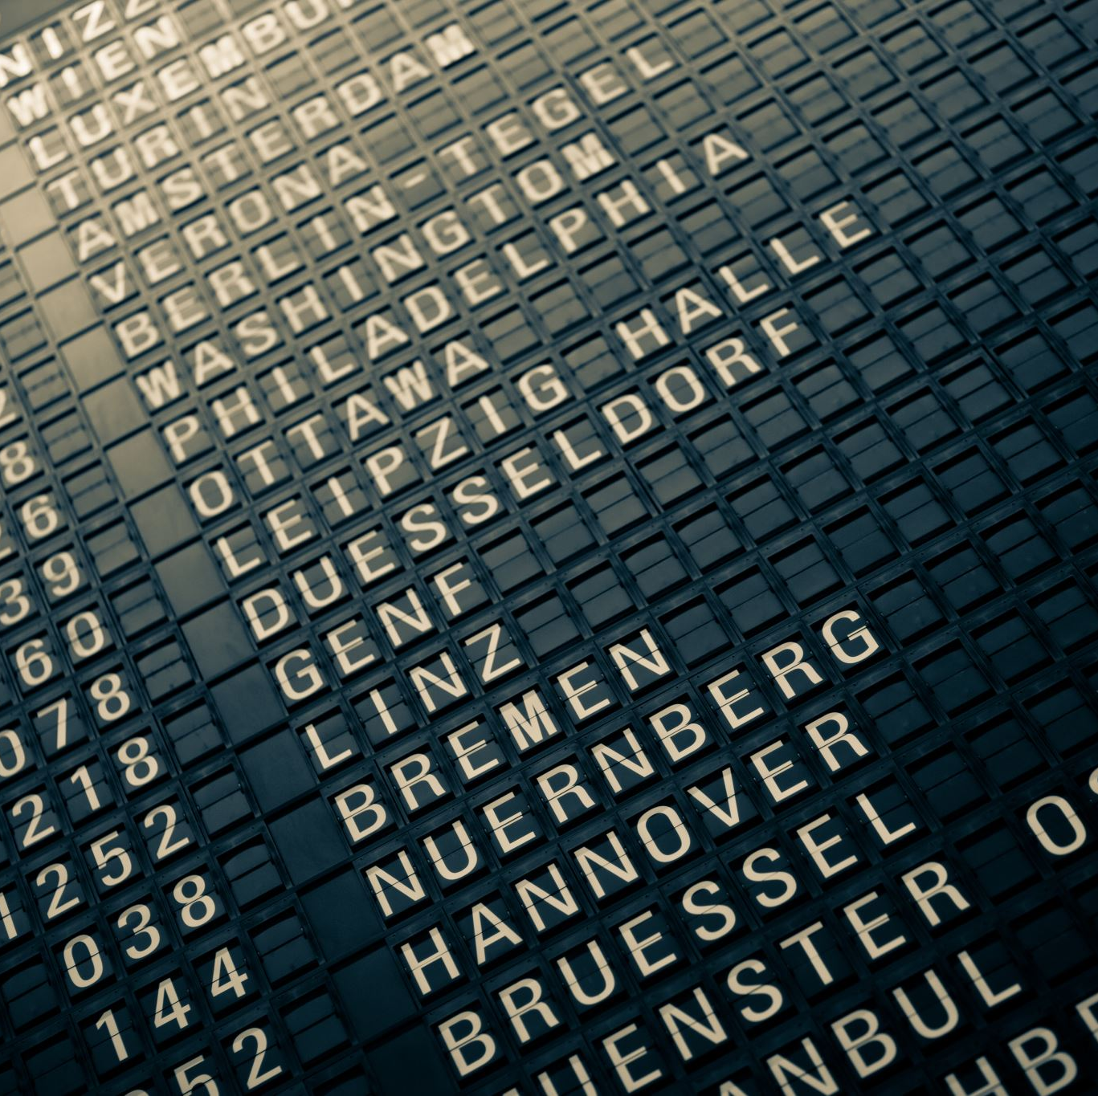
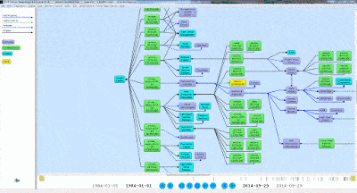
Thank you!!
https://github.com/Grant-Steinfeld

Slide 34
Resources
Evans, Colin. Programming the Semantic Web: Build Flexible Applications with Graph Data ( book on Amazon )
AllegroGraph (agraph) DB homepage, Franz Inc. https://franz.com/
N-TRIPLES spec - http://www.w3.org/TR/rdf-testcases/#ntriples.
Blog - Ontology and Data Science - Favio Vaquez

Slide 35
Resources (2)
Semantic Graphs: What they are and Why You Should Care ( Blog by David Vandegrift )
Knowledge Graphs
What is a Knowledge Graph? – IBM
The World Factbook – CIA
South Africa travel facts
Wikipedia
Dbpedia - Global and Unified Access to Knowledge Graphs
Wikidata -overview of structured data
Wikimedia / Commons
Schema.org – discover common and standard labels (Predicates (P)) https://github.com/schemaorg/schemaorg

Slide 36
Resources (3)
RDF Schema 1.1 - W3C Recommendation 25 February 2014 Developers guide to RDF predicates
https://schema.org/docs/developers.html Gruff tutorial
http://www.franz.com/agraph/gruff
http://www.franz.com/franzdownload/agraph/allegrograph/data/actors.ntriples

Slide 37
Additional, Advanced, etc … Material

Slide 38
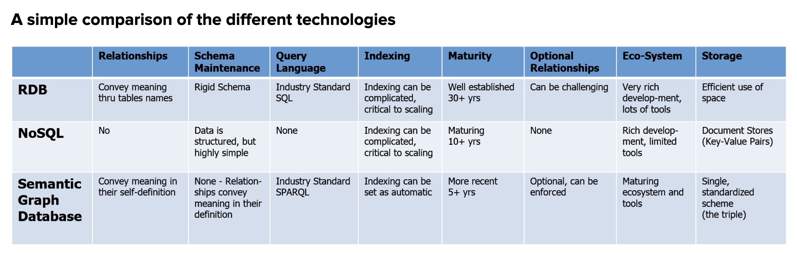
Comparison
RDBs ( MySQL, MSSQL, DB2 etc )
NoSQL ( CouchDB, MongoDB, DocumentDB, etc )
Semantic Graph DB ( Neo4j, allegroGraph(agraph) )
Notes:
How does Graph square up wrt Relational DBMS and / or NoSQL stores?

Slide 39
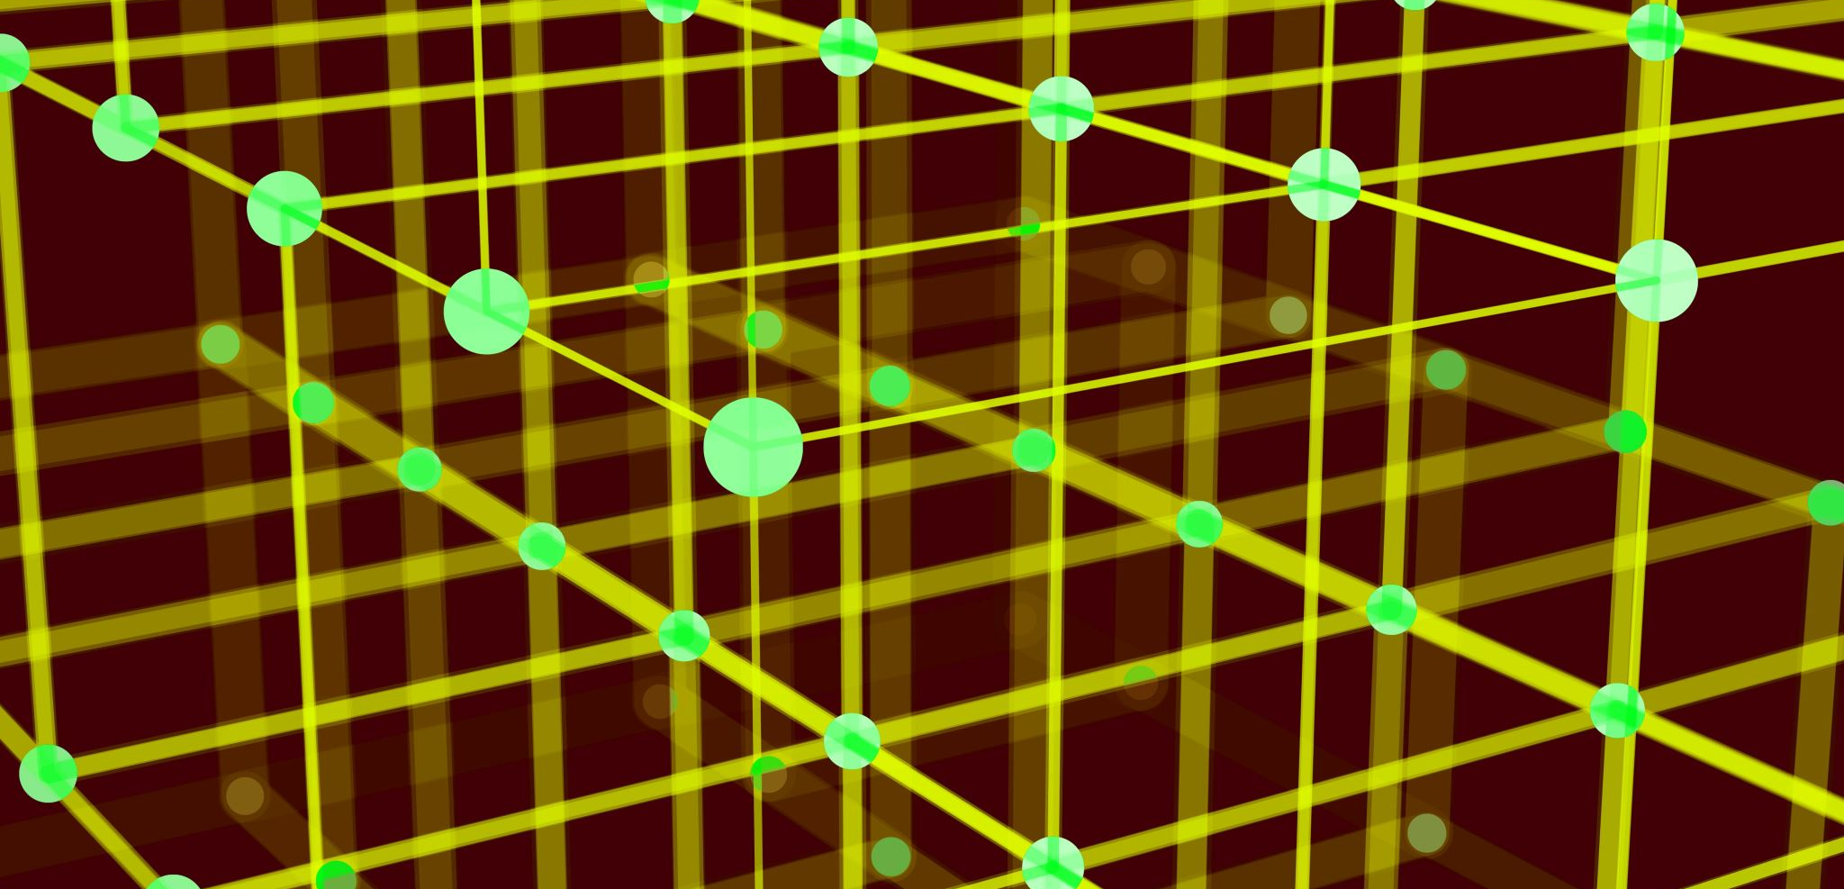
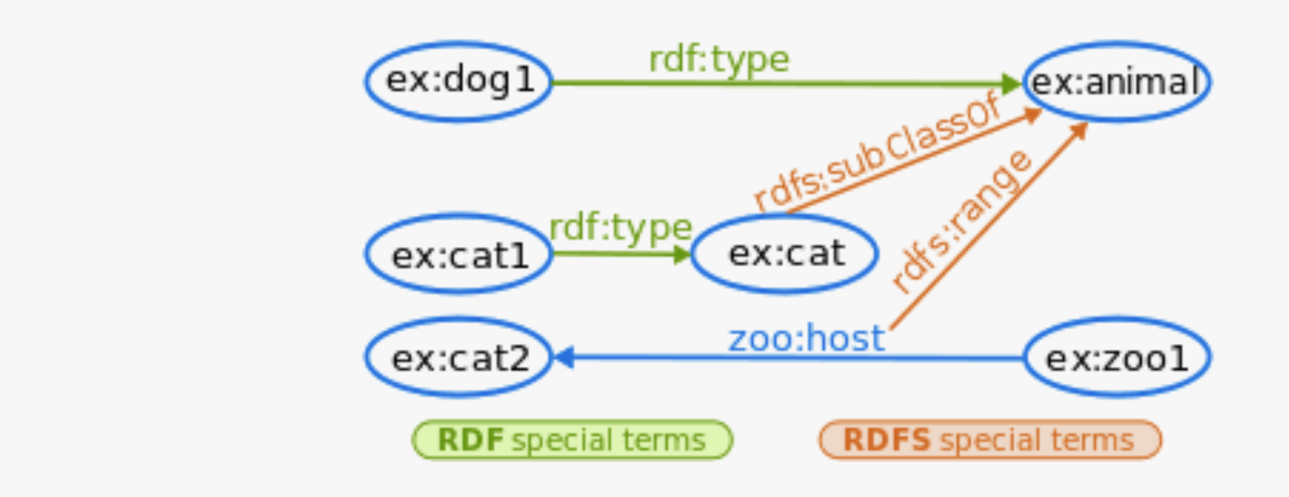
RDF – built-in Predicates
Type subClassOf range
comment

Slide 40
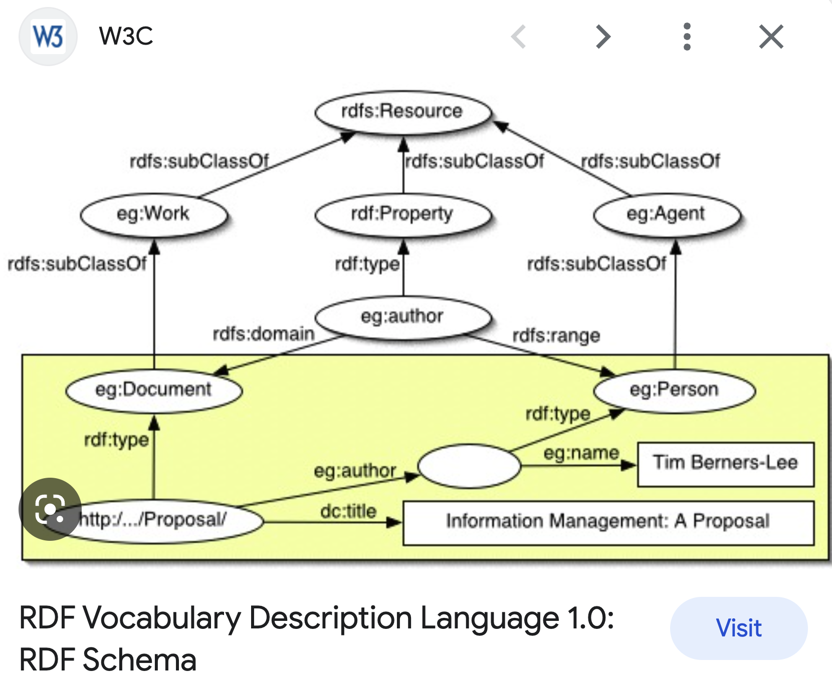
W3C – RDF Schema - A Vocabulary Description Language ver 1.0

Slide 41
Resources (4)
Ontology Completion with Graph-Based Machine Learning: A Comprehensive Evaluation (Journal article, December 2022 by Sebastian Mežnar and others )
Semantic similarity and machine learning with ontologies ( Journal article 13 October 2020 by Maxat Kulmanov, Fatima Zohra Smaili, Xin Gao, Robert Hoehndorf)
Briefings in Bioinformatics, Volume 22, Issue 4, July 2021, bbaa199, https://doi.org/10.1093/bib/bbaa199
AWS Neptune – The Good, The Bad, and the Ugly

Slide 42
RDF Vocabulary

Slide 43
Docker version of Agraph https://franz.com/agraph/docker/

Slide 44
Adding Properties to Triples in AllegroGraph
handy for security and bookkeeping purposes
Triple Attributes
TTL
https://allegrograph.com/adding-properties-to-triples-in-allegrograph/?print=print

Slide 45
Adding the “G” - > Quads
Quad (SPOG)
Subject
Predicate
Object
Named Graph
Benefit – can treat G as S or O and that itself can become a `triple`

